Slide 1

API Gateway

Slide 2
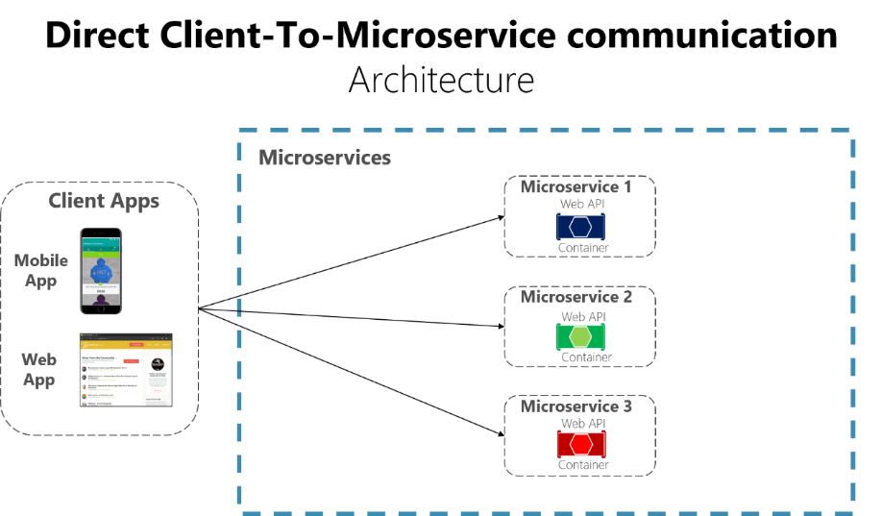

Slide 3
Consider the following questions when developing a large application based on microservices:

Slide 4
How can client apps minimize the number of requests to the back end and reduce chatty communication to multiple microservices?
How can client apps communicate with services that use non-Internet-friendly protocols?
How can you shape a facade especially made for mobile apps?

Slide 5
Why consider API Gateways instead of direct client-to-microservice communication?
Coupling
Too many round trips:
Security issues
Cross-cutting concerns

Slide 6
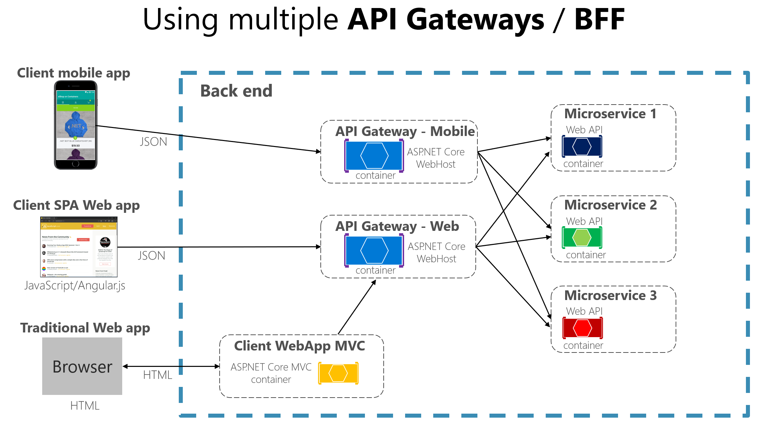

Slide 7

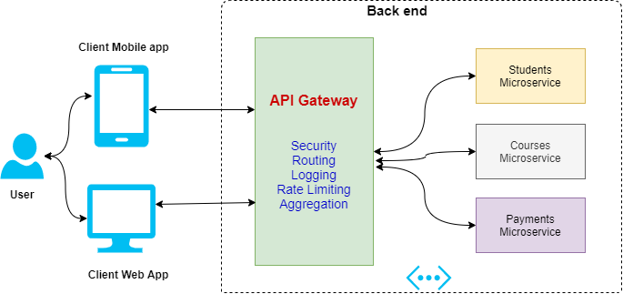

Slide 8

Distributed Tracing

Slide 9
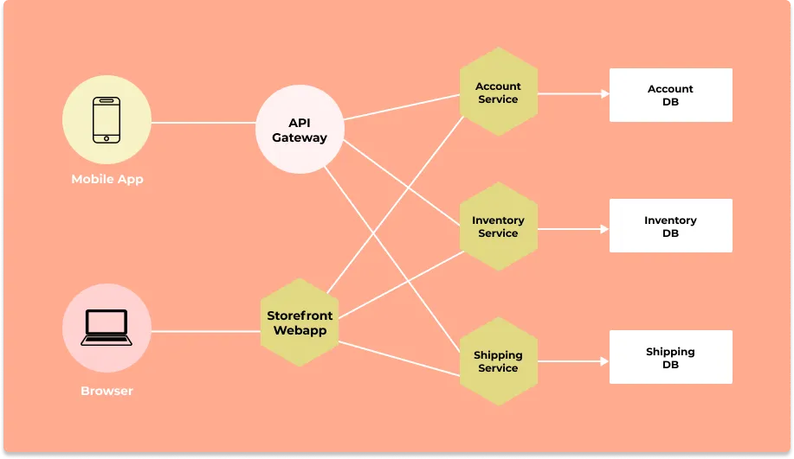

Slide 10
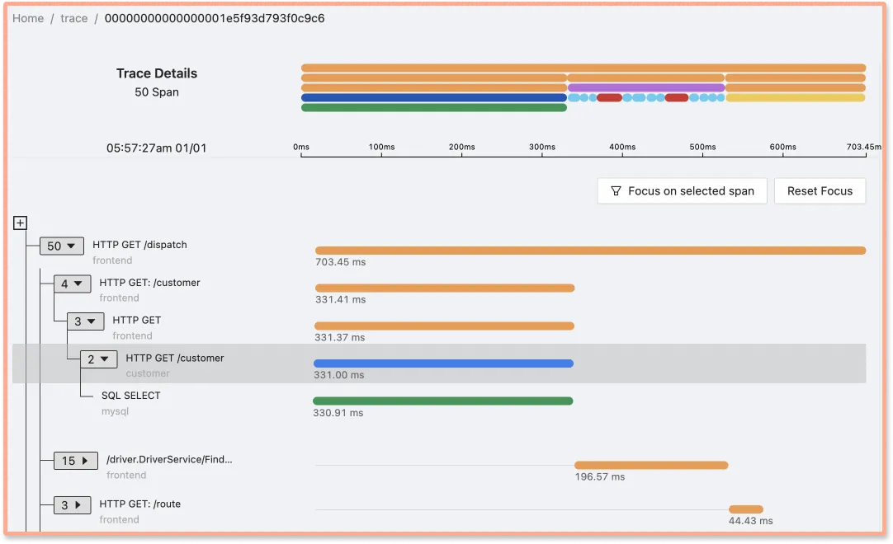

Slide 11
Distributed tracing provides answers to various questions during a debugging process
Which services did a user request go through?
How much time it took each service to process the request?
How are the services connected?
What was the failure point in case of a request failure?

Slide 12
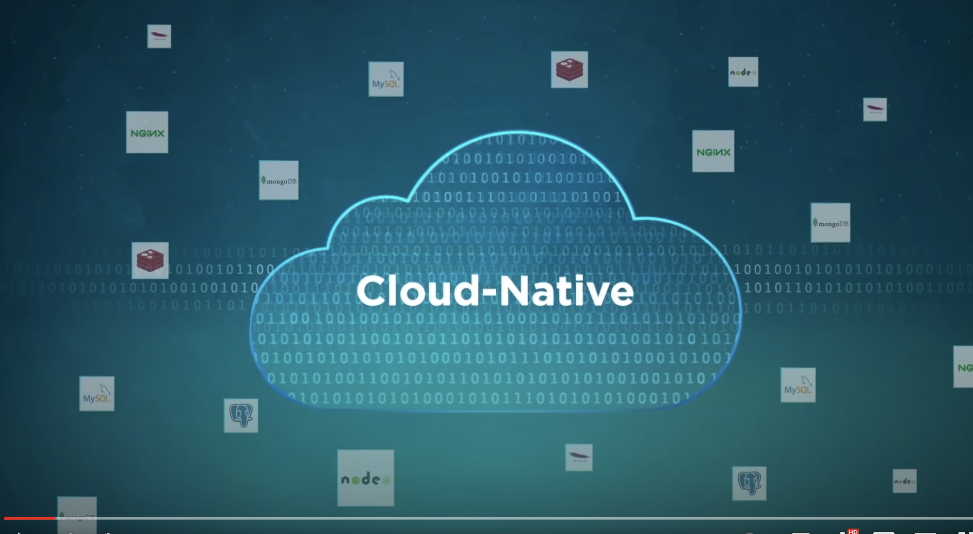

Slide 13
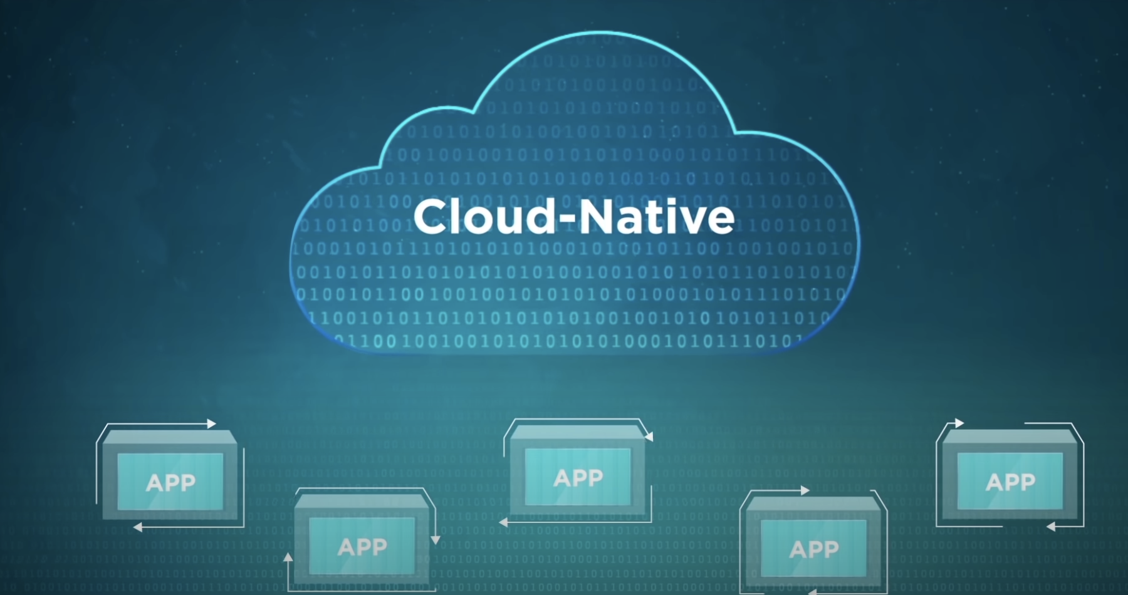

Slide 14
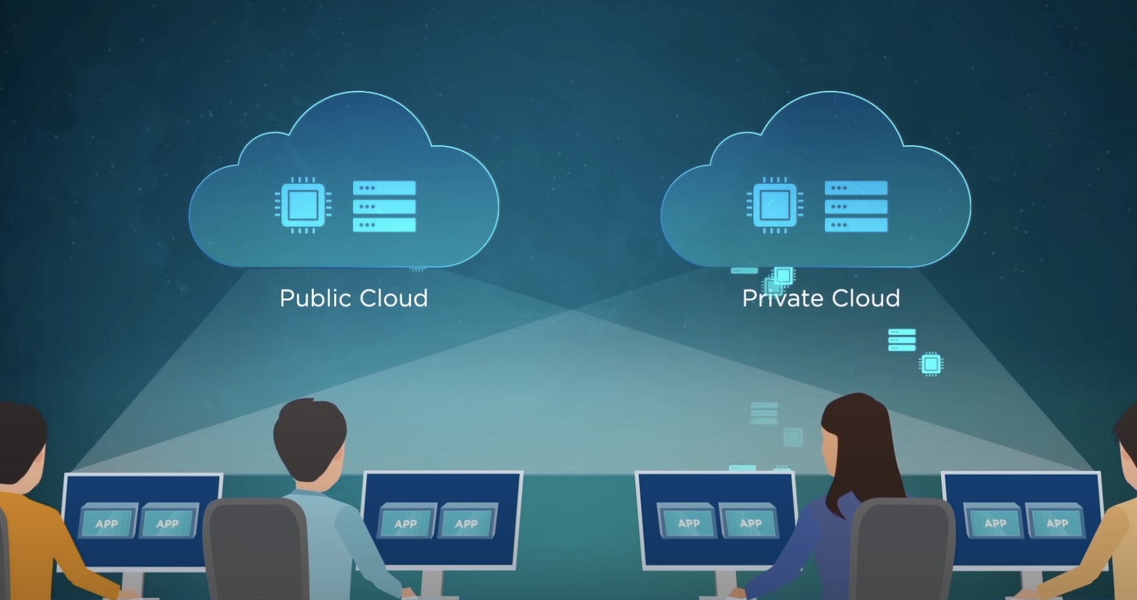

Slide 15
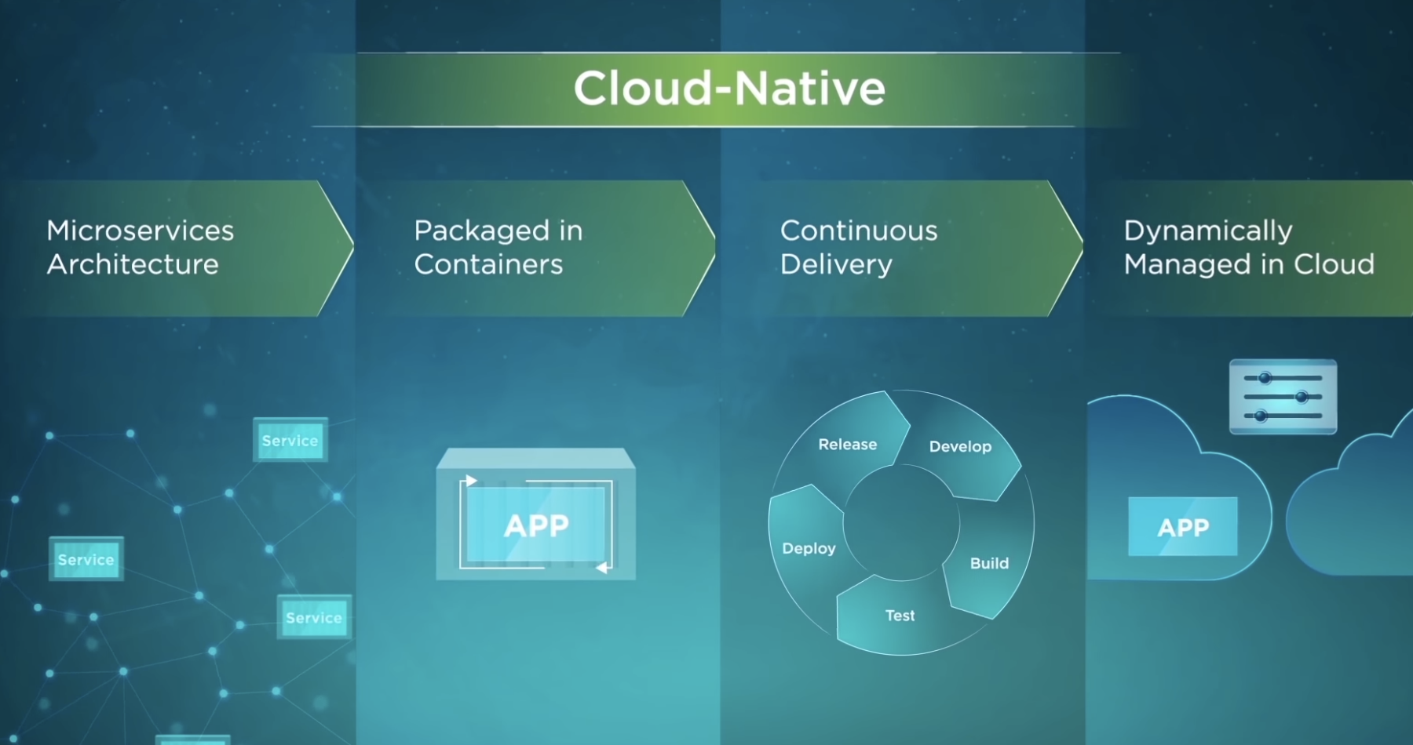

Slide 16
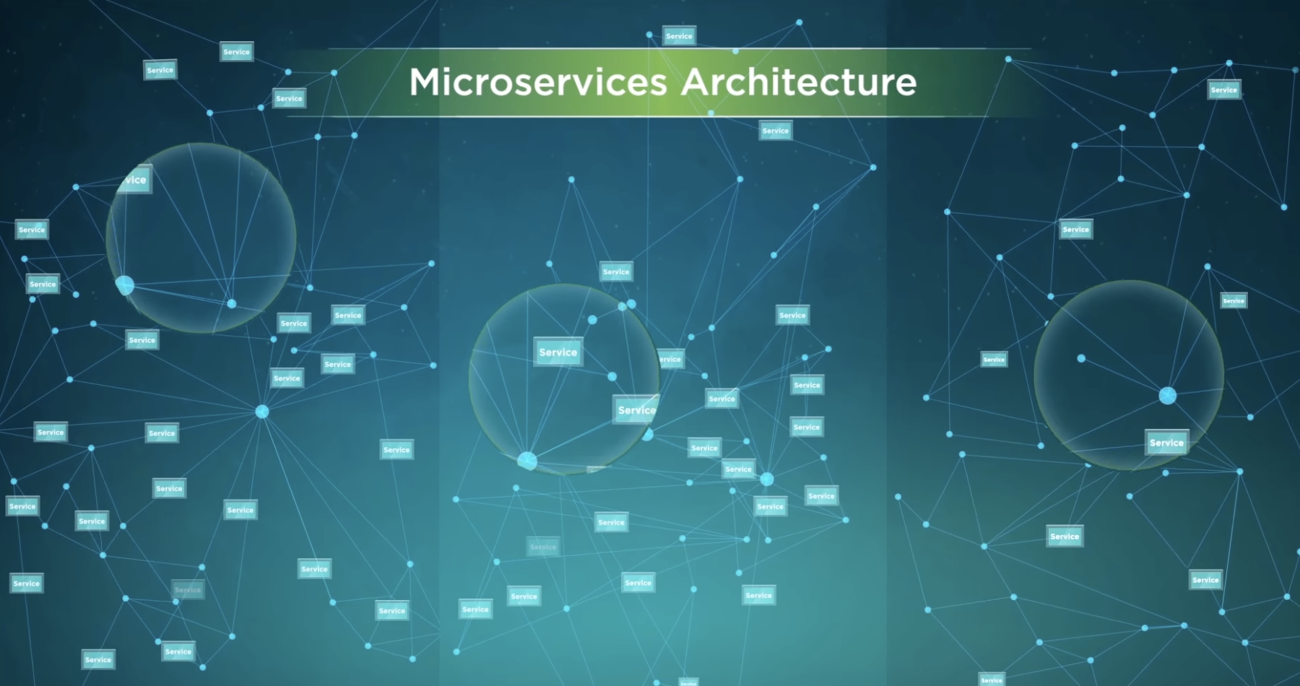

Slide 17
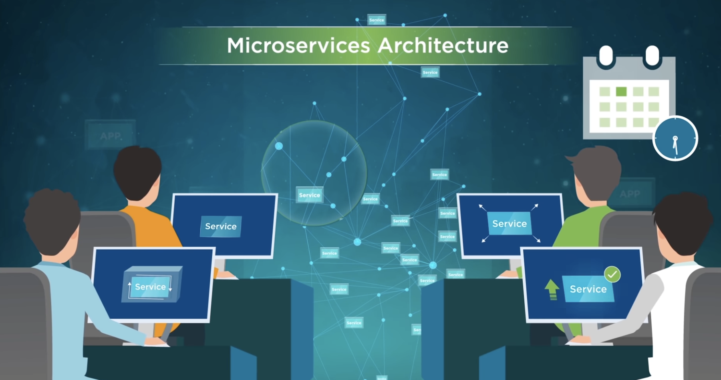

Slide 18
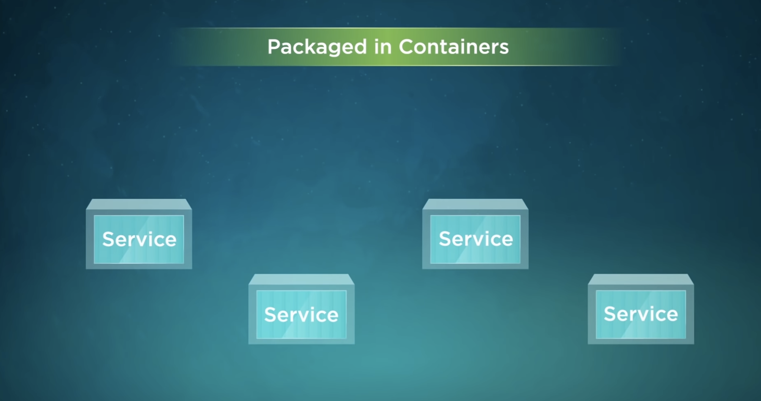

Slide 19
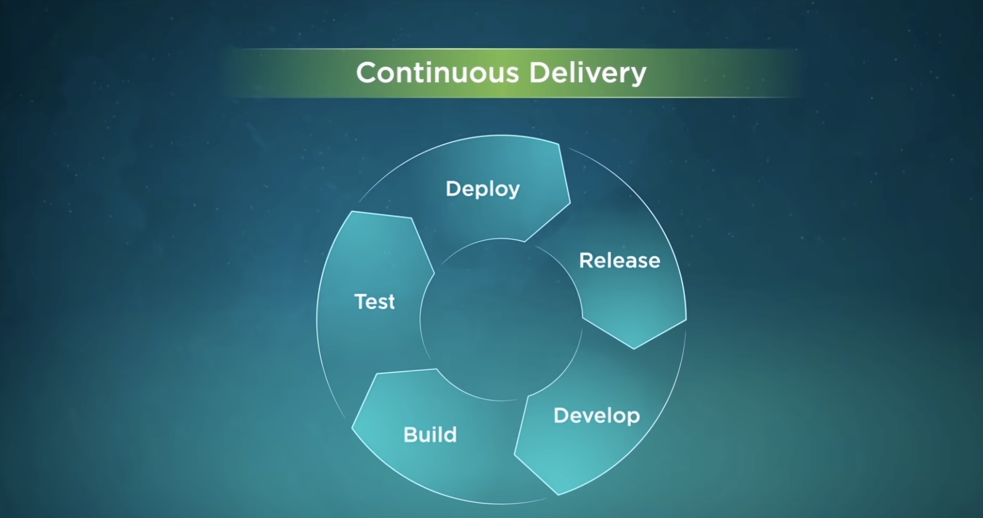

Slide 20
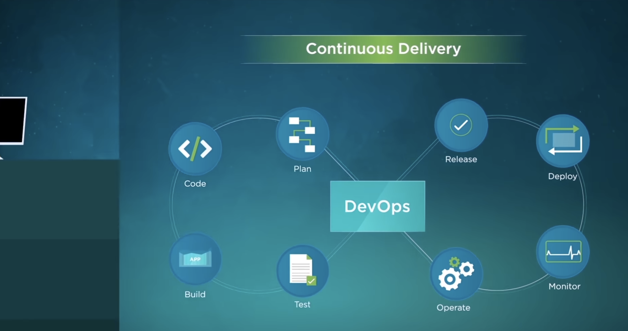

Slide 21
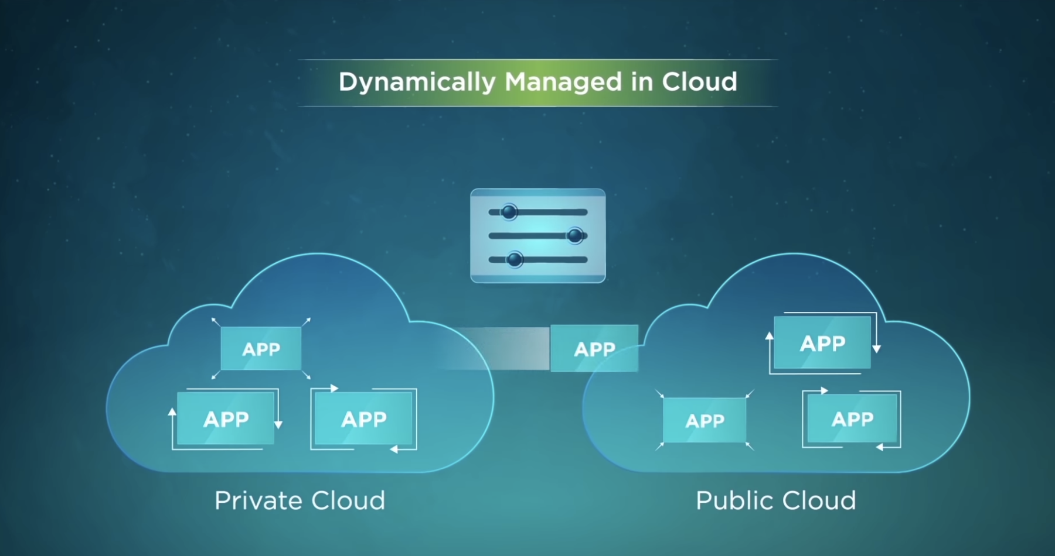

Slide 22
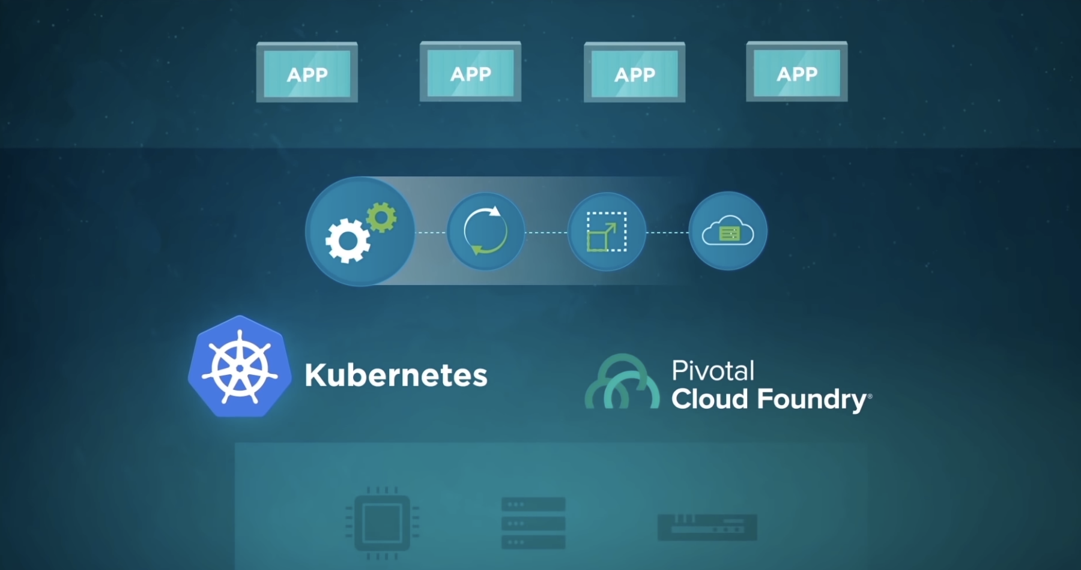

Slide 23
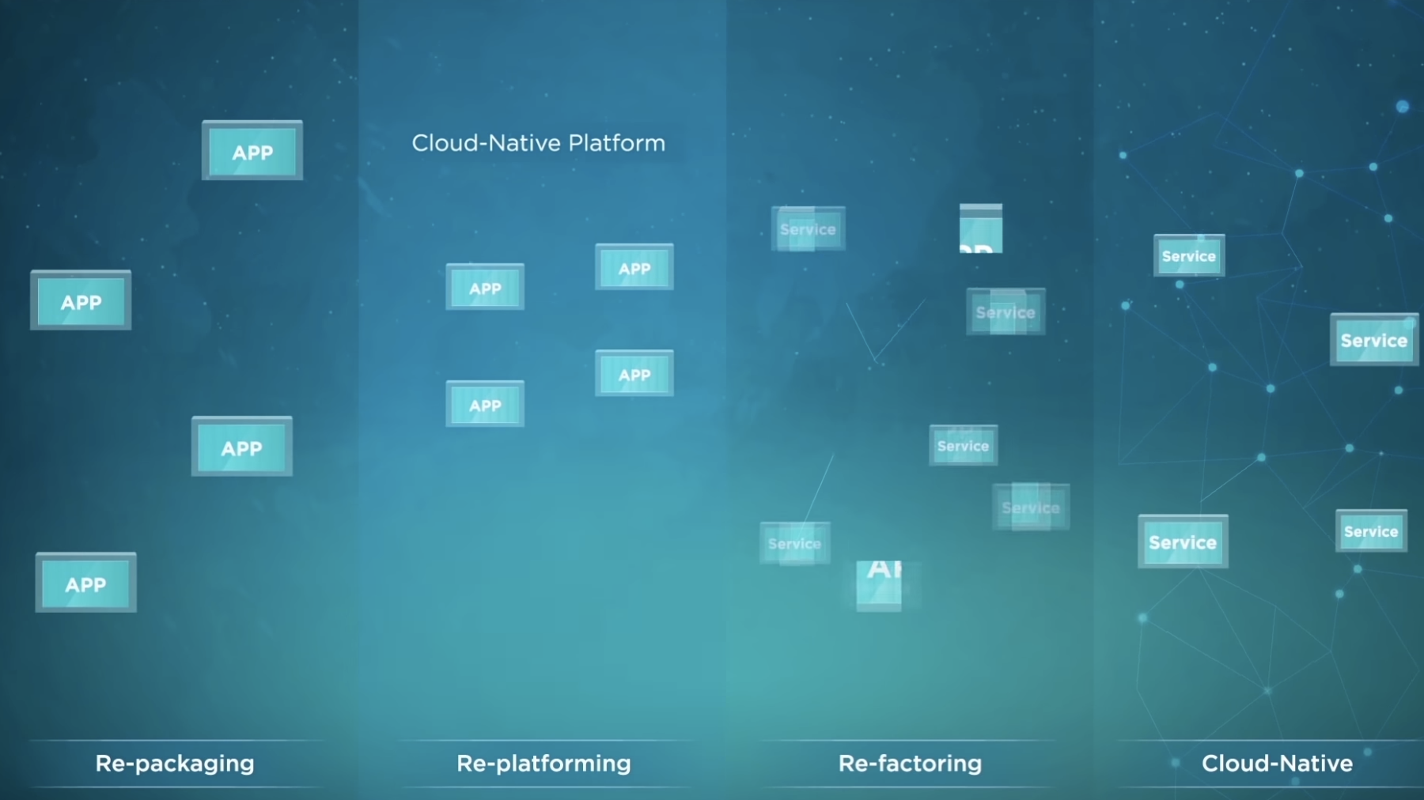

Slide 24
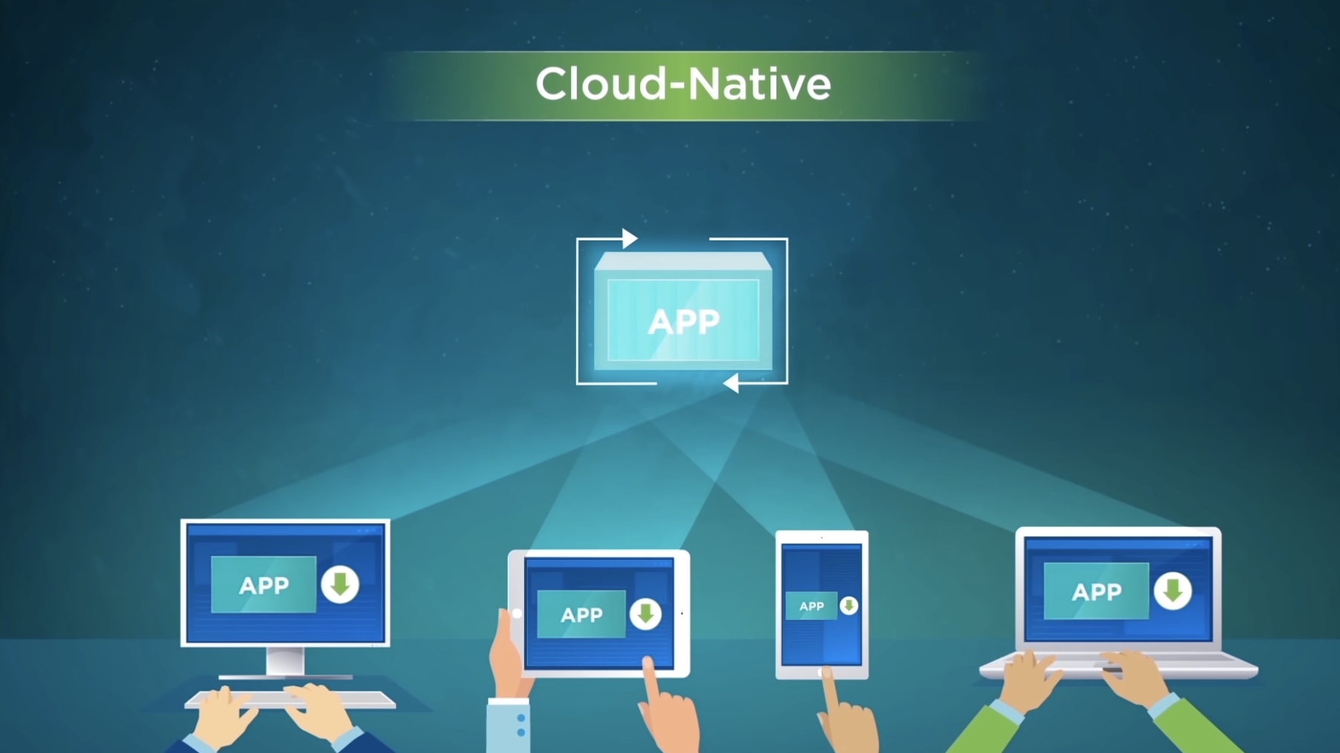

Slide 25
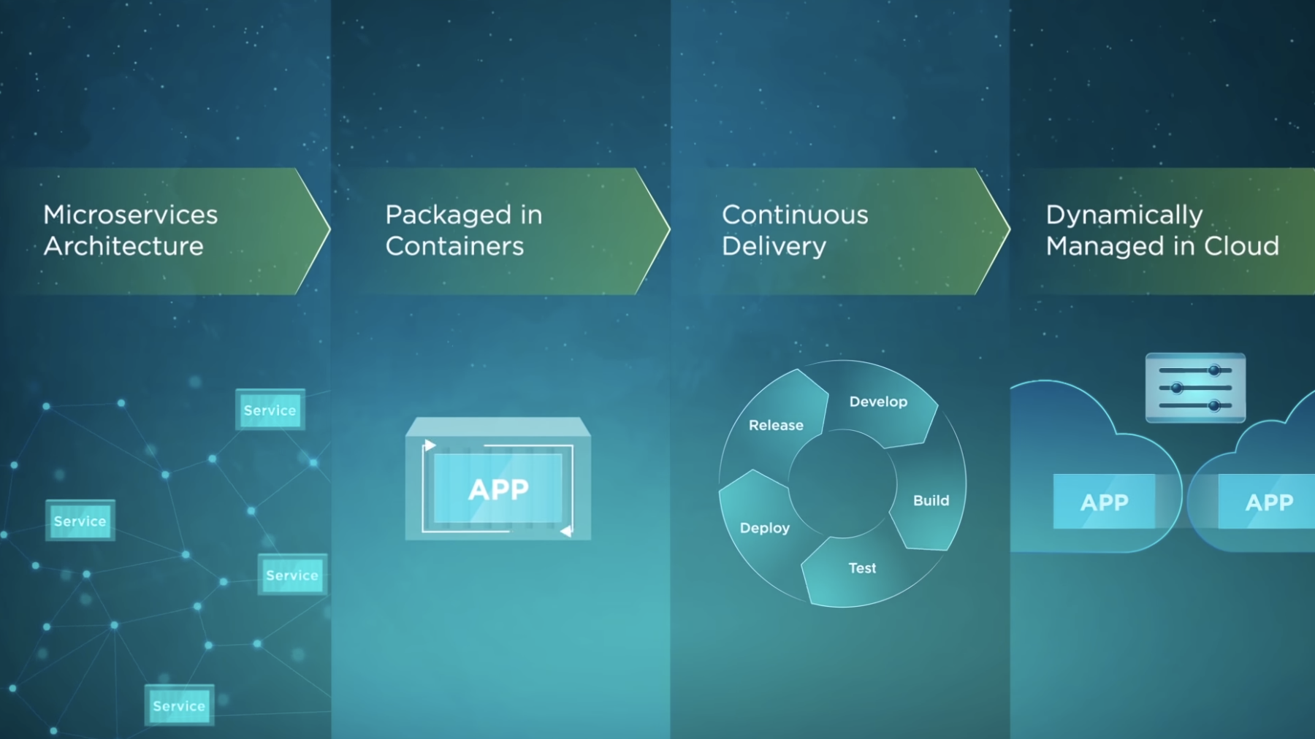

Slide 27
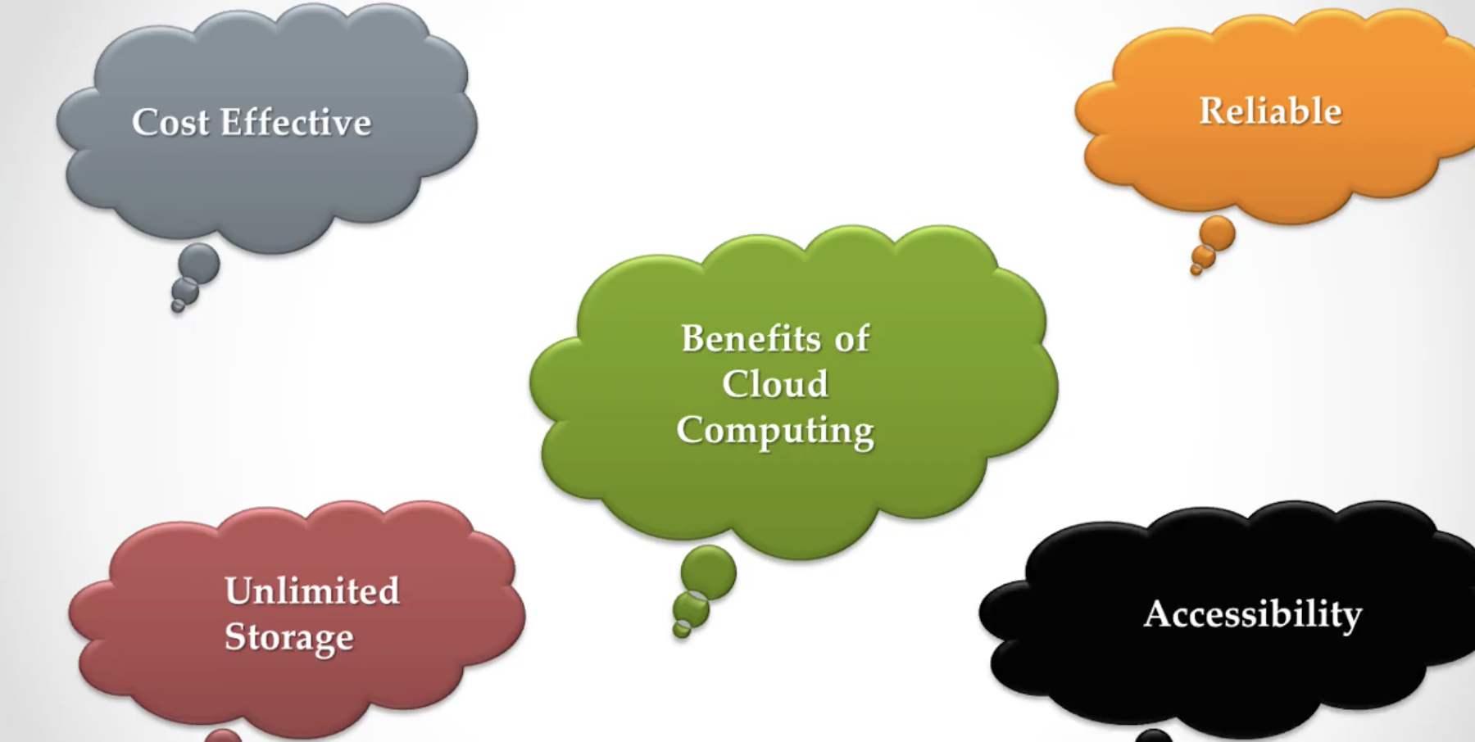

Slide 28
